Slide 1
The Battle of Neighborhoods of two cities
Coursera Capstone
IBM Data Science Professional Certificate
By: Rajeev Kavety

Slide 2
Problem
The top 10 most common venues misses the niche market, such as, food courts.
Identifying food courts can be useful for the entrepreneurs who want to setup a business.
The challenges of overlaying the top most common venues having food courts on the maps of Toronto and Manhattan, can address both preferences of the public.

Slide 3
Data
Used scrapping techniques demonstrated by beautiful soup4, and using the python results package
The neighborhood data was extracted from the Wikipedia link.
For Toronto map coordinates, the information in a CVS file was downloaded from the link http://cocl.us/Geospatial_data . For the Manhattan neighborhoods dataset, the link is in the json format. https://geo.nyu.edu/catalog/nyu_2451_34572.
Foursquare API
Foursquare API is a location data provider that uses RESTful API calls to retrieve data about most common venue categories in each neighborhood within a radius of 500m.

Slide 4
Methodology
Exploratory Data Analysis
For Toronto city, Neighborhoods of North Toronto, Central Toronto, West Toronto, East Toronto, Downtown Toronto, North York, East York, York, and Etobicoke are taken.
Another is Manhattan neighborhoods of New York.
To focus on the scope of this project, food courts along with the venues was combined to the top 10 venues list.

Slide 5
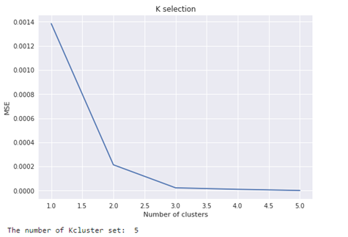
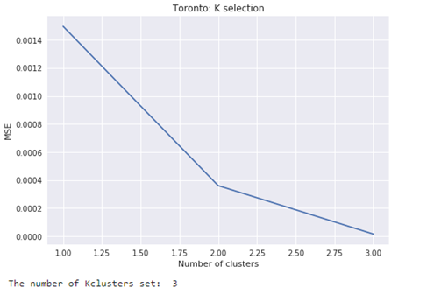
Unsupervised Machine Learning
Using the K-means clustering algorithm- Elbow method, the cluster number is estimated

Slide 6
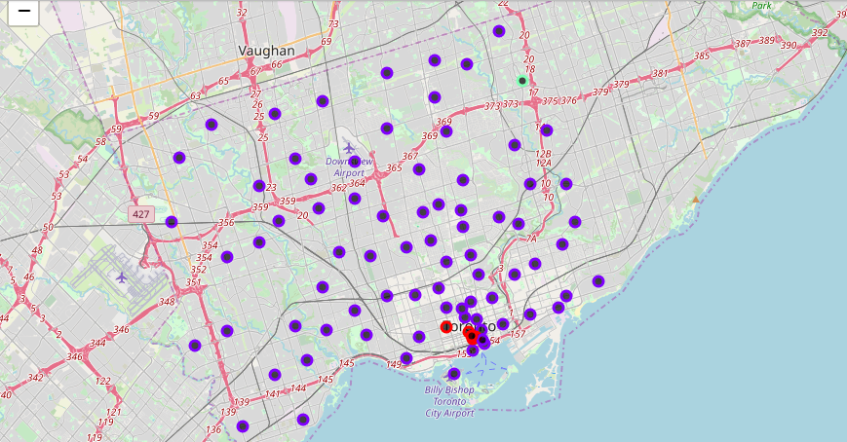
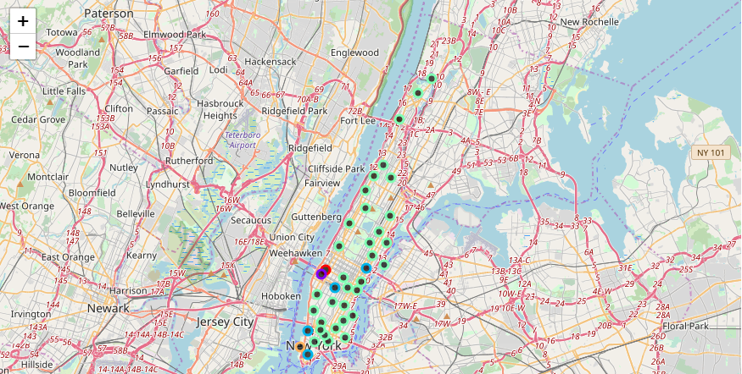
Results
Toronto Map with clusters showing food court at top venues
Manhattan Map with clusters showing food court at top venues

Slide 7
Conclusions
The precedence of food courts in some of the top 10 venues, gives an insight for the niche market of food courts.
Visitors prefer to visit the location that has food courts as well as other top most venues.
Overlaying food courts with top most venues gives information for the start-up entrepreneurs of a business opportunity.
Including population density would have been helpful for in-depth insight to the entrepreneurs.

Slide 8
Thank you

